Slide 1
Kubernetes
Quan Luu & Lam Vu

Slide 2
Agenda
What is Kubernetes
Kubernetes Architecture

Slide 3
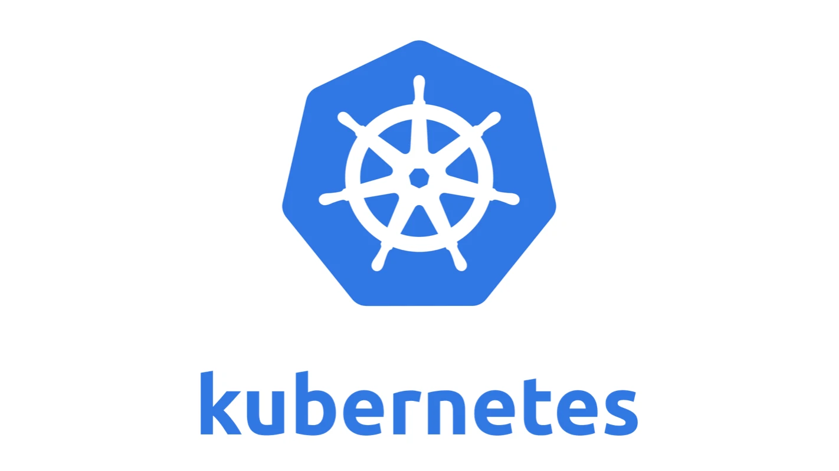
What is Kubernetes?
Introduction to Kubernetes
Kubernetes is software system that allows us to
Deploy and manage containerized apps
Run service on thousands of computer nodes
Kubernetes can help microservices to
Work together as a team so they need to communicate to each other
Configure all of servers to desired state

Slide 4
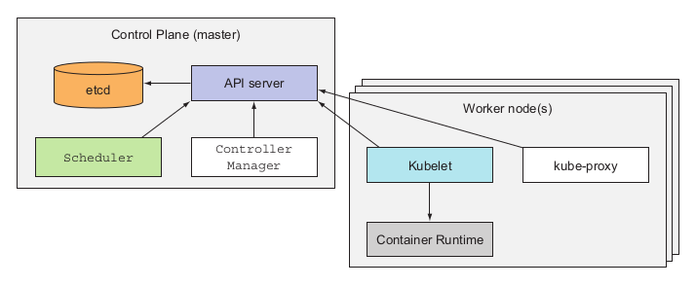
What is Kubernetes?
What Kubernetes does?
Kubernetes includes
A master node: host Kubernetes Control plane that controls and manage Kubernetes system
Any number of worker nodes: run apps we deploy

Slide 5
What Kubernetes does?
Control Plane
Control plane is to control the cluster
API server: Kubernetes components communicate with
Scheduler: assigns a worker node to each service of app
Controller Manager is to
Keep track of worker nodes
Handle node failures
etcd: DB to store cluster config

Slide 6
What Kubernetes does?
Worker node(s)
Control plane is to run containerized apps, includes
Docker, or any container runtime
kubelet: communicate with API server to manage containers on its node
kube-proxy: load-balance traffic between app components

Slide 7
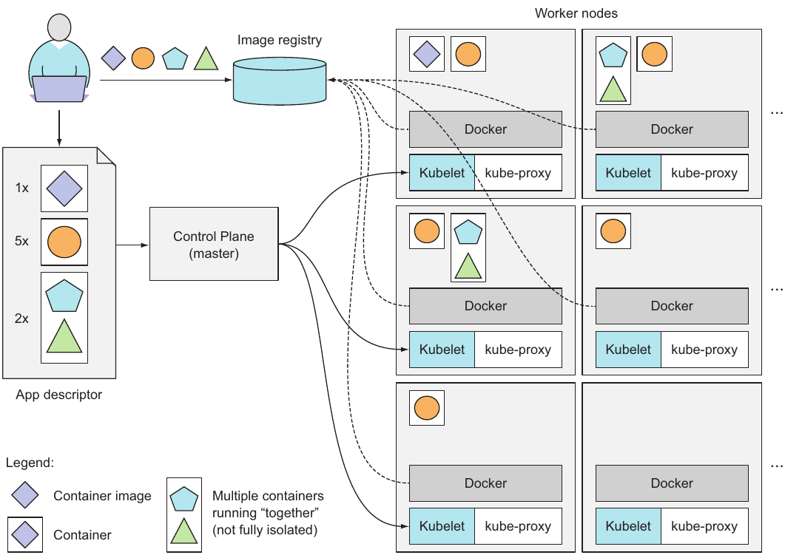
What Kubernetes does?
Running an app in Kubernetes
To run an app in Kubernetes
Package it into container image
Push those images to an image registry
Post a config of our app to Kubernetes API server

Slide 8
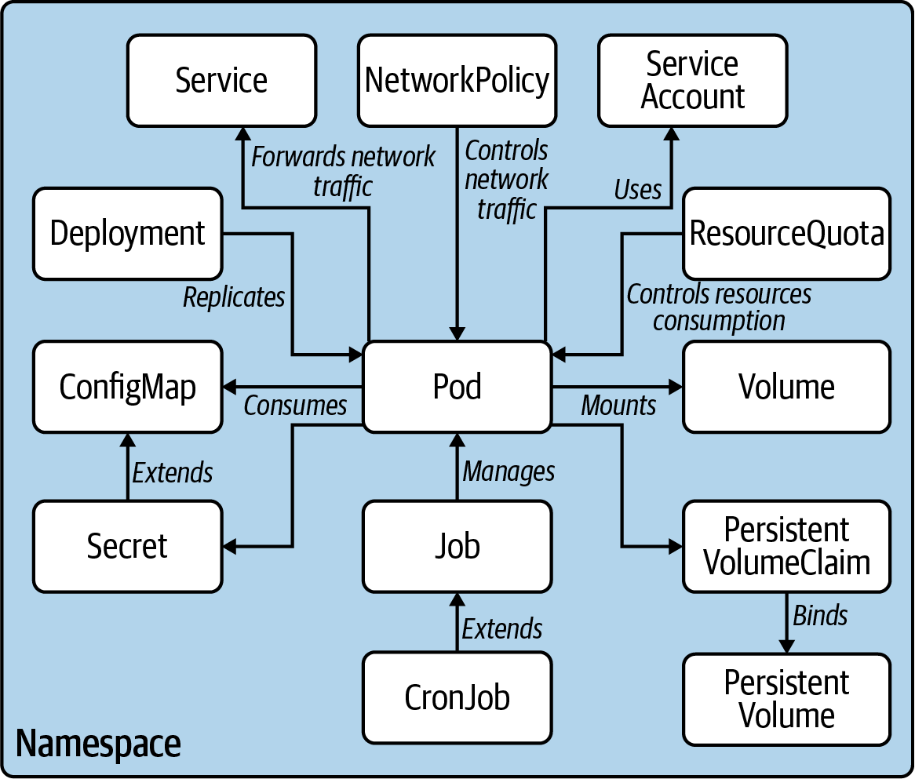
Kubernetes Architecture
Kubernetes Primitives

Slide 9
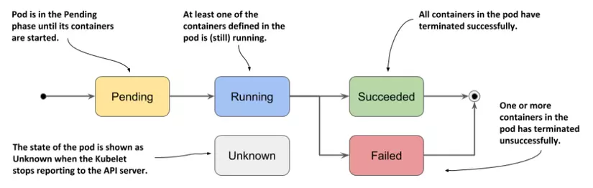
Pod
Smallest deployable unit in K8s cluster.
A group of one or more containers with shared storage and network resources.

Slide 10
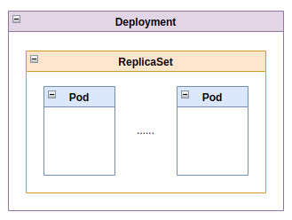
Replication Controller, ReplicaSet and Deployment
Ensure a specified number of pod replicas is running at any one time.
Automatically create new pods if the number of specified pods is under expectation.
Automatically delete pods if the number of specified pods if over expectation.

Slide 11
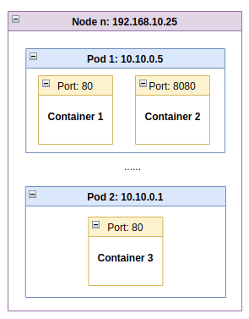
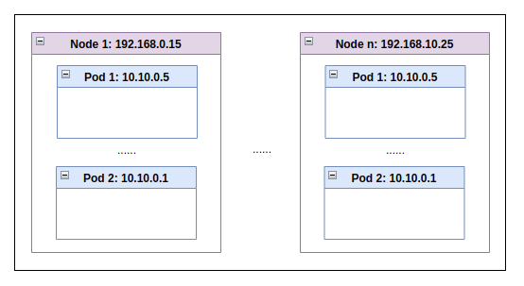
Service
How to assign tasks for pods?
Worker nodes
Pods in a worker node

Slide 12
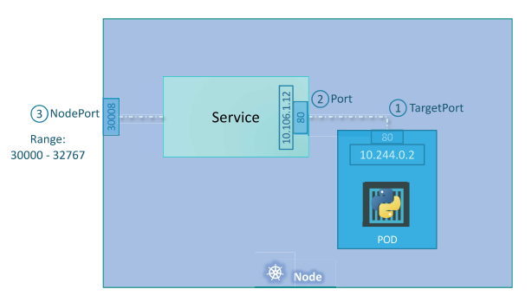
Service
A service is an abstraction which defines a logical set of Pods and policy by which to access them.
Set of target Pods is determined by a selector.

Slide 13
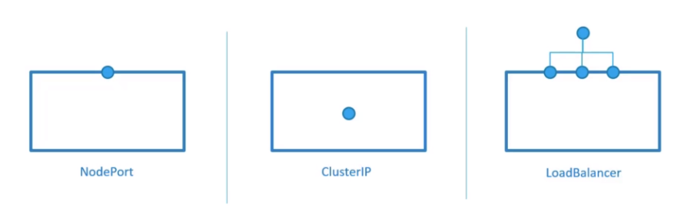
Types of Service

Slide 14
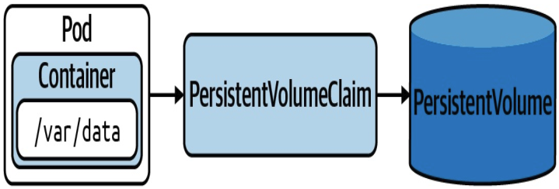
EmptyDir, Local Path, PersistentVolume and PersistentVolumeClaim
EmptyDir: Empty directory in Pod with read/write access. Only persisted for the lifespan of a Pod.
LocalPath: File or directory from the host node’s filesystem.
PersistentVolume: The storage device in a Kubernetes cluster.
PersistentVolumeClaim: Requests the resources of a PersistentVolume
Notes:
EmptyDir: useful for sharing files between containers running in the same pod or when a container needs to write data to disk temporarily.

Slide 15
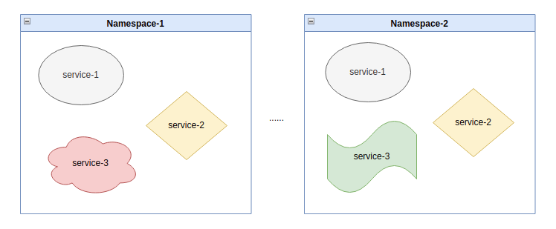
Namespace
Provides a mechanism for isolating group of resources within a single cluster.
Applicable for namespaced objects: Deployments, Services,....
Not applicable for cluster-wide objects: StorageClass, Nodes, PV,....

Slide 16
Job and CronJob
Job: A Job is a set of desired Pods that we want to run completely.
Non-parallel Jobs: only one Pod
Parallel Jobs with a fixed completion count
Parallel Jobs with a work queue
CronJob: create Jobs on a repeating schedule.

Slide 17
ConfigMap and Secret
Store data that define environment variable.
→Enable to change configuration data values without redeploy the Pod.
Store in form of key-value pair.
ConfigMap is mount as Volume to filesystem path.
Secret: suitable for storing sensitive data like passwords, API keys.

Slide 18
Thank you

